Slide 1
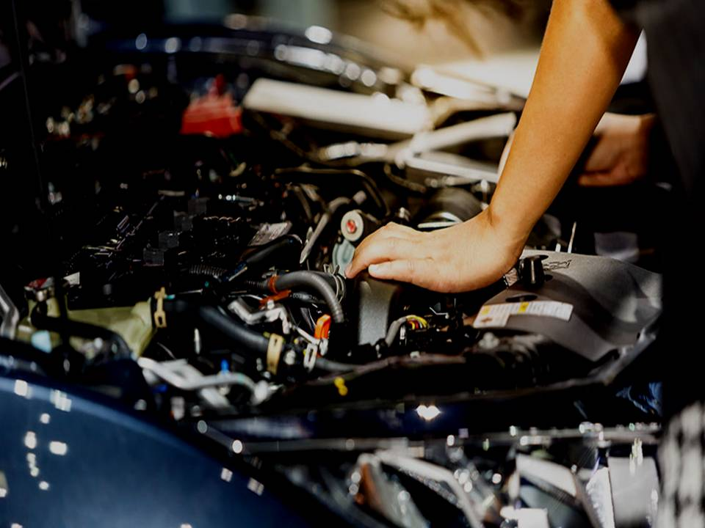
Vehicalsolution
Group – 9
FATIN ISRAQ TABIB – 2022280
FARHAN MASUD KHAN PATHAN– 2022214
SYED ZESHAAN RIZVI– 1830395
FARDIN ISLAM- 1921562

Slide 2
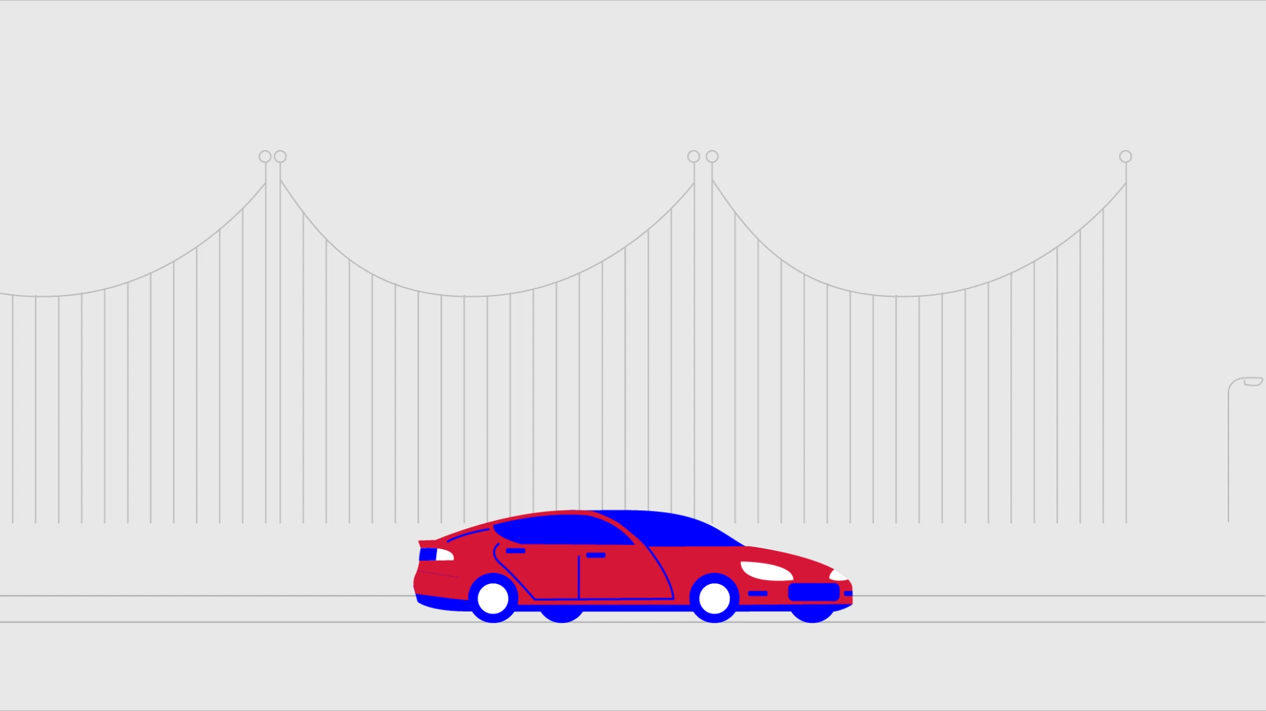
Introduction:
This project aims to develop a website that allows users to find car workshop around their location. The website will enable users to search for workshop by location, services offered, and other factors that are essential for their car maintenance needs. The website will use Geolocation technology to determine the user's current location, making it easier to find nearby workshop.

Slide 3


Objectives
The primary objective of the project is to create a user-friendly website that makes it easy for car owners to find garages around them.
The website will offer a range of search filters to help users find garages that meet their specific needs, such as service type , reviews, and distance.

Slide 4

Methodology
MySQL
HTML
Website Developed
CSS
Google Map API
FLEXBOX
JavaScript
PHP
Bootstrap

Slide 5

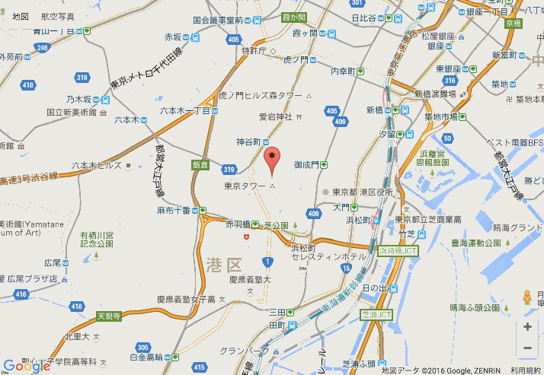
key features of the website
1. Search Functionality
2. Google Maps Integration

Slide 6
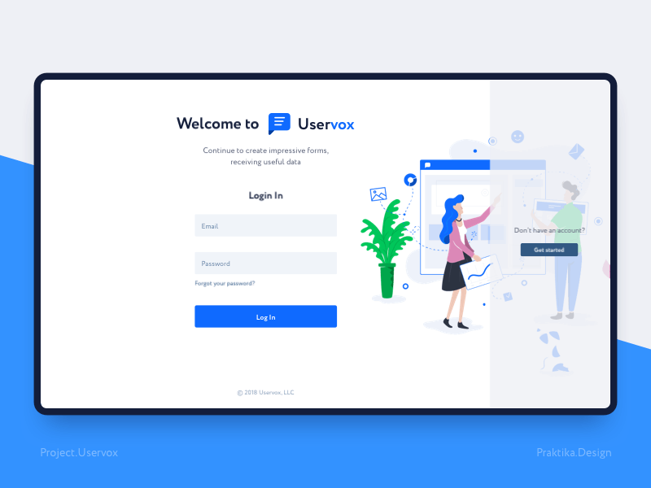
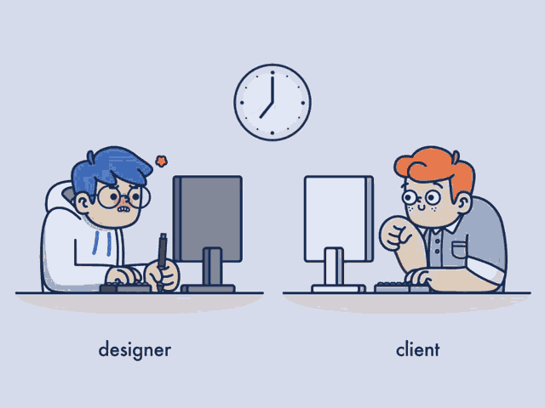

3.User Accounts
5.Responsive Design
4.Reviews

Slide 7


